Slide 1
Lecture 6 Confidence intervals
Kristin Privitera-Johnson
FISH 553 Advanced R
School of Aquatic and Fishery Sciences
University of Washington

Slide 2
Questions to answer
~
Estimate the parameters ( , K, σ) for this equation separately for males and females [done]
Calculate 95% confidence intervals for asymptotic length
Can we conclude that asymptotic length differs for males and females?

Slide 3
Plot the data
Code model
Confront model with data
Ask a question
plot()
VB.NLL()
mle2()
Linf?

Slide 4
Likelihood profiles
Likelihood profiles are a way of estimating confidence intervals for a particular model parameter when the model is fitted using maximum likelihood
Statistical theory is not important here, so just accept it for this course… (see likelihood ratio test).
The problem: we have a model based on a set of parameters θ = {X₁, X₂, X₃, ..., X_{n}}. We want the 95% confidence interval for one parameter, say X₁. The negative log-likelihood function is –lnL(data|θ)

Slide 5
Steps in likelihood profile
Fit the full model to find the maximum likelihood estimates (MLEs) for all parameters, with corresponding lowest negative log-likelihood –lnL_{best}
Select a wide range of values for X₁ from well below to well above its MLE value: A₁, A₂, ..., A_{m}
Fix parameter X₁ to the first of these values, A₁, and find the values for all other parameters X₂, X₃, ..., X_{n} that will minimize –lnL(data,X₁=A₁| X₂, ..., X_{n})
Save the resulting negative log-likelihood –lnL_{X1=A1}
Repeat steps 3 and 4 for X₁=A₂, ..., X₁=A_{m}
Plot –lnL_{X1={A}} – (–lnL_{best}) against the values of X₁

Slide 6
Visual likelihood profile
Negative log-likelihood, fixing the
parameter to each value in turn
(minimize on the rest of the parameters)
–lnL
–lnL
–lnL_{best}
•
•
•
•
•
•
•
•
A₁
A₂
A₃
A₄
MLE
A₅
A₆
A_{m=7}
Parameter of interest (X₁)
Alternative
values for the
parameter

Slide 7
Application to Von Bertalanffy
To compute a likelihood profile for L∞ for males
Extract the data for males, fit the model and find the MLE; saving the –lnL as –lnL_{best}
Based on the fit, select a reasonable range for L∞, and choose a set {A₁, ..., A_{m}} of equally spaced values in this range
Fit the model fixing L∞ to A₁, minimizing over K and σ, store the –lnL_{L∞=A1}. Repeat for A₂, A₃, etc., until you have the –lnL for all values in the range
Plot!

Slide 8
Model code returning –lnL
VB.NLL <- function(Linfinity, K, sigma) {
gender <- "Male"
LA <- read.csv(file="Data//LengthAge.csv")
ages <- LA[LA$Gender==gender,]$Ages
lengths <- LA[LA$Gender==gender,]$Lengths
model.predL <- Linfinity*(1-exp(-K*ages))
ndata <- length(ages)
NLL <- -sum(dnorm(x=lengths,
mean=model.predL,sd=sigma,log=TRUE))
return(NLL)
}

Slide 9
Finding the best –lnL
require(bbmle)
MLE.res <- mle2(minuslogl=VB.NLL,
start=list(Linfinity=50, K=0.2, sigma=10),
method="L-BFGS-B",
lower=list(Linfinity=20, K=0.02, sigma=0.1),
upper=list(Linfinity=500, K=1, sigma=100))
bestNLL <- -1*logLik(MLE.res)[1]
bestNLL
coef(MLE.res)
Store the results of fitting the model
Returns the lnL (not the –lnL)
Accesses the best estimates for each parameter

Slide 10
Within each profile step
When using mle2(), the start=, lower=, and upper= arguments will contain values only for K and sigma, not Linfinity since we are fixing Linfinity
The fixed= option will point to the particular value of Linfinity being profiled, e.g.
fixed=list(Linfinity=100)
fixed=list(Linfinity=105)
fixed=list(Linfinity=110)

Slide 11
Algorithm for obtaining profile
Find the best –lnL [done]
Use this to create a vector Linf.values to profile over (loop through)
Find the number of elements in this vector, nLinf
Create an empty vector profNLL to store the NLL values for each value in Linf.values
Loop through the Linf.values values, at each step use mle2 to minimize the function
Store the –lnL in element i of the profNLL vector
Plot Linf.values against profNLL. Done!

Slide 12
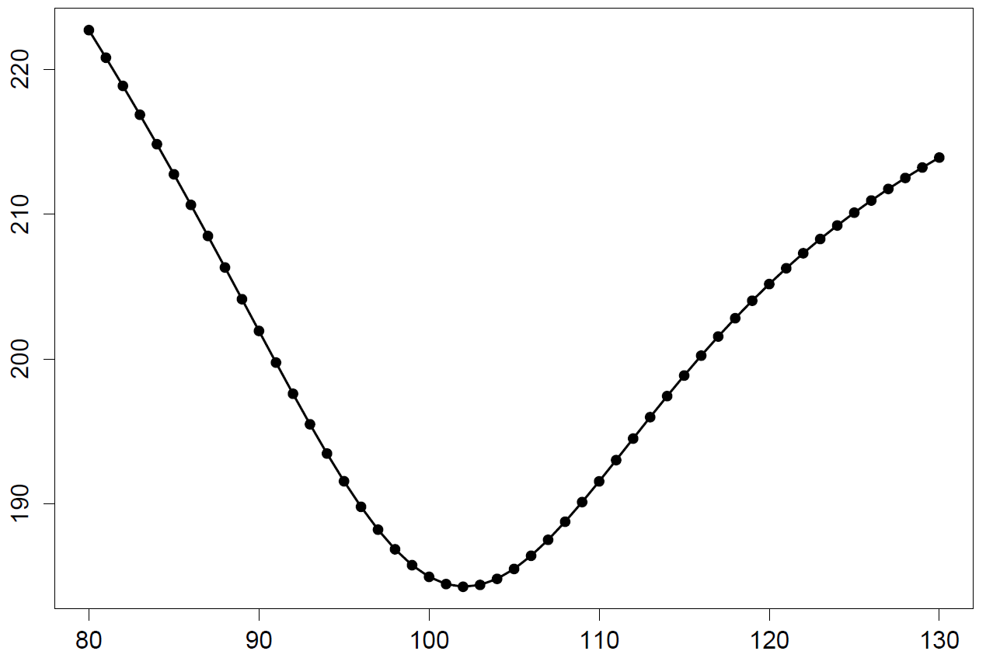
In-class exercise 1: profile
Starting with "7 Code template.r", create code to profile over Linfinity from 80 to 130 cm for males. If you have time, profile over females too.
–lnL
Linfinity (cm)

Slide 13
Confidence intervals
Confidence intervals can be computed directly from the likelihood profile
For a single parameter, the 95% confidence interval is 1.92 log-likelihood units away from the lowest negative log-likelihood
Obscure technicalities: chi-square distribution with 1 degree of freedom at the 5% level is 3.84. The 1.92 is half of this and is related to the likelihood ratio test.

Slide 14
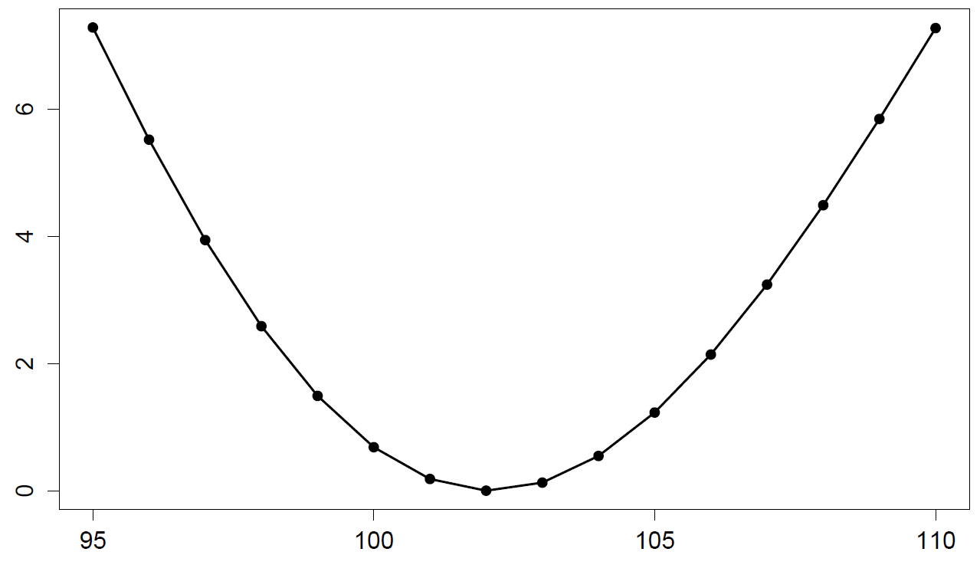
Computing 95% CIs
Subtract –lnL_{best} and find the points where the resulting likelihood profile is 1.92 units away from the lowest point
95% confidence intervals
–lnL – (–lnL_{best})
Linfinity (cm)

Slide 15
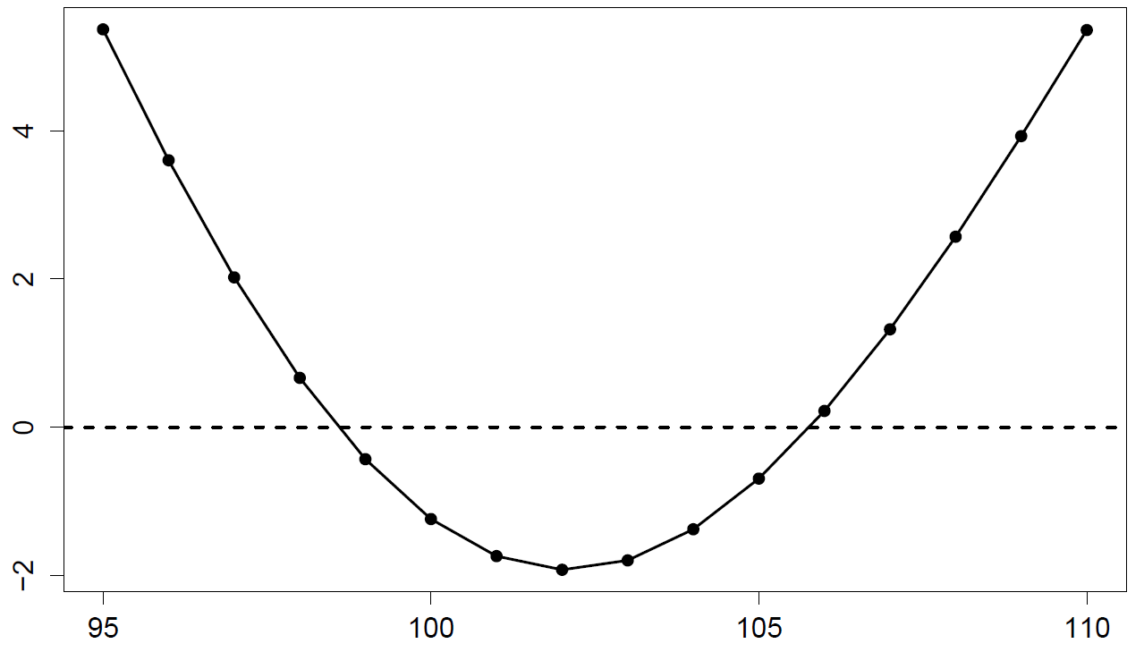
Using uniroot to find 95% CI
The function uniroot() finds x values that result in a function y being equal to zero (i.e. the “roots” of the function)
Key recognition: the likelihood profile equals zero when:
–lnL – (–lnL_{best}) – 1.92 = 0
–lnL – (–lnL_{best}) – 1.92
Linfinity (cm)

Slide 16
Create a new function VB.uni()
The function will be zero when the –lnL is
1.92 units from –lnL_{best}.
VB.uni <- function(Linfinity, bestNLL,
targetNLL=1.92) {
#at this point call mle2 and extract tempNLL
return(tempNLL-bestNLL-targetNLL)
}
VB.uni(Linfinity=97, bestNLL=bestNLL)
[1] 2.022249 #testing: you should get this
VB.uni(Linfinity=101, bestNLL=bestNLL)
[1] -1.734966 #more testing
VB.uni(Linfinity=98.5788, bestNLL=bestNLL)
[1] -9.332921e-05 #close to zero

Slide 17
Now call uniroot()
The function uniroot() searches between lower and upper for values of x that result in func(x) = 0
func <- function(x, a, b) {
return(x-a)
}
uniroot(f=func, lower=x.LME, upper=150, a=10, b=5)
uniroot(f=func, lower=80, upper=x.LME, a=10,b=5)
additional function parameters added at the end
uniroot will vary the first parameter until func(x, a, b)==0

Slide 18
Lower 95% CI: uniroot could search between these upper and lower values to find where Linfinity = 0
Upper 95% CI:
uniroot could search between these upper and lower values to find where Linfinity = 0
–lnL – (–lnL_{best}) – 1.92
Linfinity (cm)

Slide 19
In-class exercise 2
Use uniroot() to find the two values of Linfinity that are targetNLL=1.92 units above the bestNLL. You should get results similar to those below for the lower root
uniroot( #figure out the function call )
$root
[1] 98.57871 #value of Linfinity
$f.root
[1] 9.664733e-09 #should be close to zero
$iter
[1] 6 #how often VB.uni() was called
$estim.prec
[1] 6.103516e-05 #precision of root

Slide 20
Questions to answer
Estimate the parameters ( , K, σ) for this equation separately for males and females [done]
Calculate 95% confidence intervals for asymptotic length [done]
Can we conclude that asymptotic length differs for males and females? [test: does 95% CI overlap for males vs. females]

Slide 21
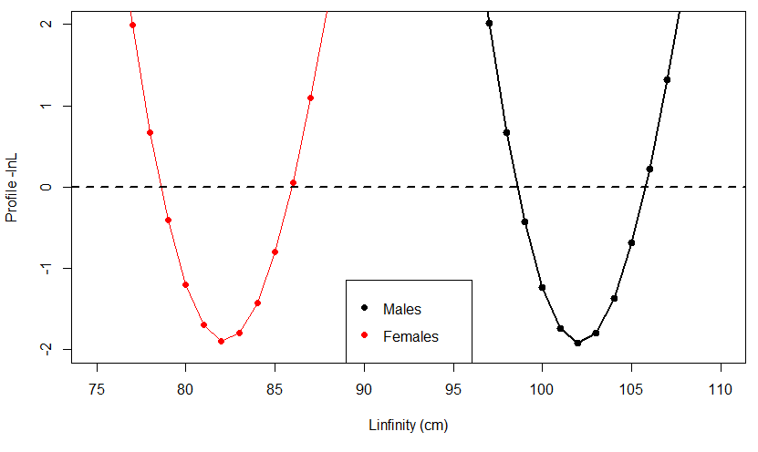
Check for overlapping intervals

Slide 22
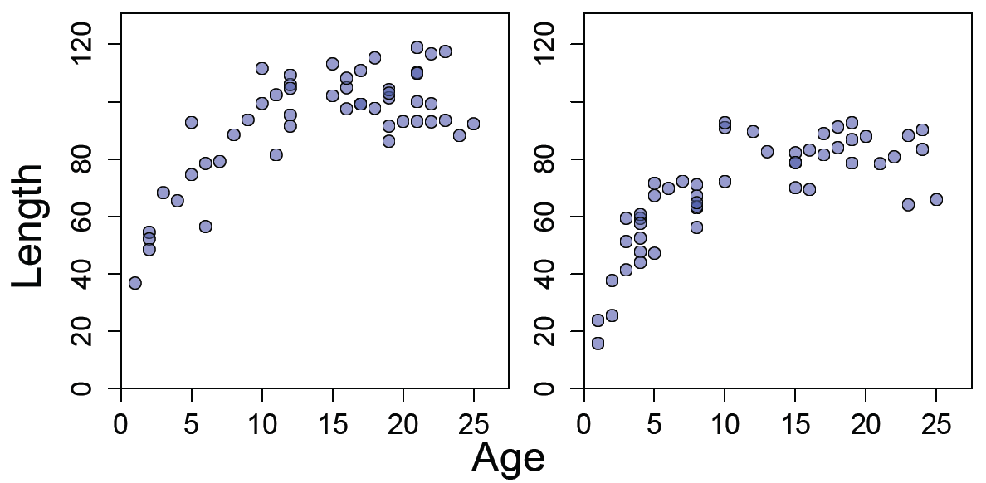
This makes sense looking at the data
Males are significantly bigger than females at older ages.

Slide 23
Better way of testing part 3 (beyond scope of FISH553)
Q: Does asymptotic length differ for males and females?
Find NLL1 when fitting VB equation to all data combined.
Find NLL2 fitting VB equation, using Linf1 for males, and Linf2 for females, but the same K value for both
Calculate AIC = 2×(number of params) + 2×NLL for steps 1 and 2
Lowest AIC is the best model, so if AIC is lower from 2 then Linf is different, otherwise Linf is similar
This method is covered in FISH458.

